Slide 1
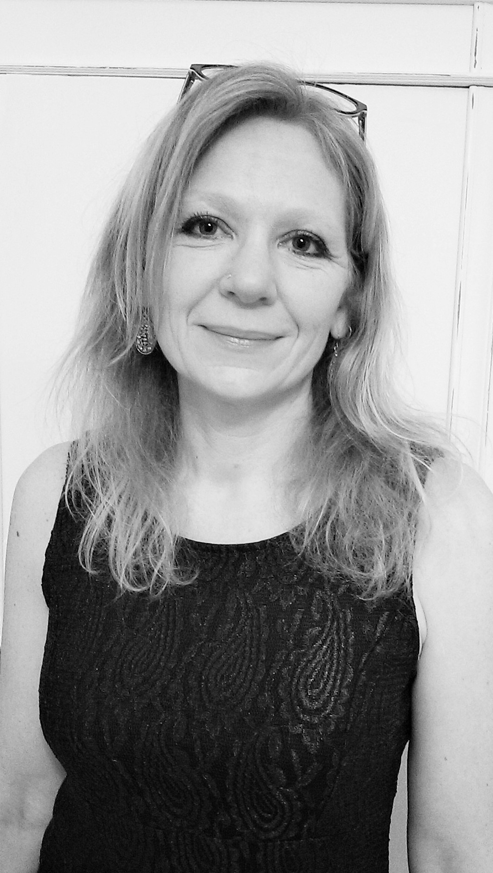
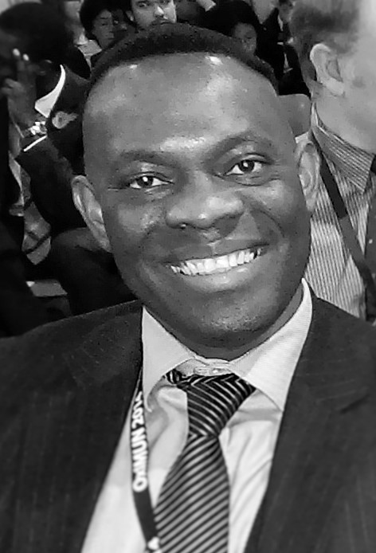
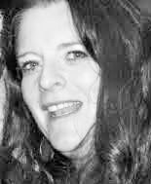
BSL/Sign Systems Audit Report
Team from Heart of Deafness:
Louise Cole, Brian Kokoruwe, Rosie Rutherford.

Slide 2
BSL/Sign Systems Audit Report:
A snapshot of current practice that supports children and young people (0-25) with sensory impairment in their development and use of BSL and/or sign systems
March 2015
Date: March 2015 , Version: P1rc3 Status: For Publication

Slide 3
Lessons across the spectrum of deafness.
Key themes from the:
National Sensory Impairment Partnership
BSL and sign systems in practice audit.

Slide 4
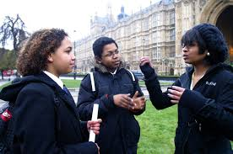
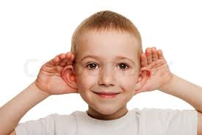
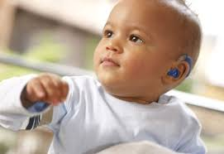
Improving outcomes for children and young people throughout their journey.

Slide 5
The process: An Ecological Approach
CYP with SI
Human Rights
National Policies
Local Authority Policy
Educators Parents / Carers
Set out the standards within the legal frameworks (Equality Act 2010, UN Convention on Rights of Disabled Persons,UN Convention on the Rights of the Child.)
How are these expressly stated in these policies?
How have these influenced policy and practice for CYPs with SI
2002 SEN Code of Practice Guidelines (draft 2014 SEN Code of Practice)
Children and Families Act 2014
Refer to standards set out by Specialist agencies
What policies do LA and other education settings have on provision for Deaf and SI CYP?
What impact did these policies have on the type and level of provision available?
What is the relationships between assessment and provisions offered or available?
What training, support and information is available to parents, carers and professionals?
What is the quality of this offer? How will we measure this?
What are the opportunities to embed learning within other SEN reforms; Local Offer, Funding, Post 16 Transitions, EHC Plans?
CYP with SI.
How does it equip the CYP to have equality of access to information and opportunity?
What are the outcomes for the CYP in terms of attainment; educational social, emotional and health based?
What benchmarks can be developed to ensure high expectations and measurement?

Slide 6
Getting it right for every deaf child.
Key themes:
Collaborative and empowering approach
Child centred
Workforce Development, mandatory
qualifications, training, quality and standards
Leadership and management
Data collection , analysis and application
Getting it right for every deaf child

Slide 7
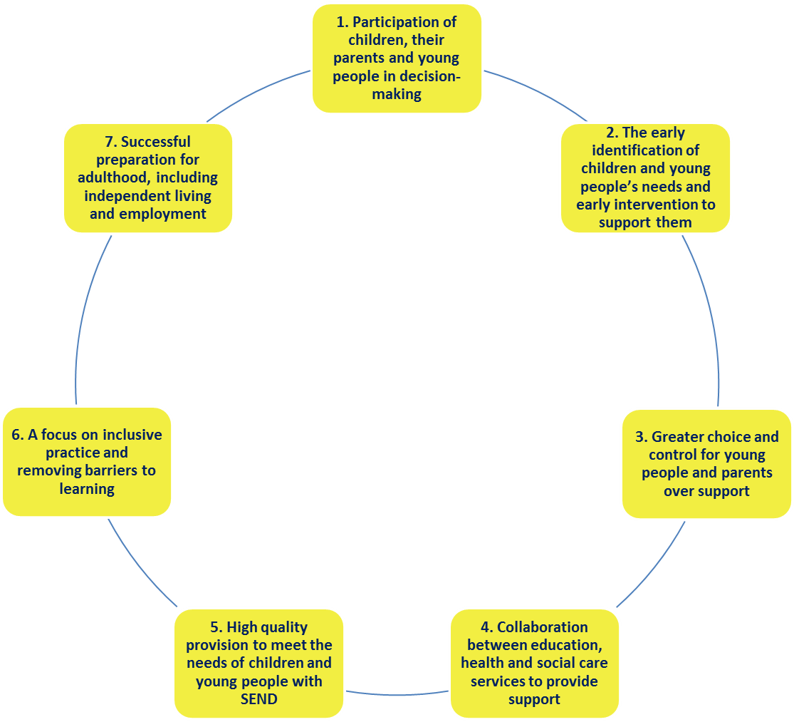
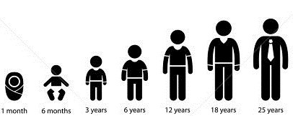
Supporting positive outcomes Looks like this:

Slide 8
1. Participation of children, their parents and young people in decision-making
What worked (Case Study Extract Number) | Outcomes for child | Learning
1) Mother ran BSL club for other parents when child began mainstream school. | Child socially included – barriers removed with other families, child invited to play. Child is sociable and gets on well with peers. | Proactive action to promote whole school inclusion. Supporting others to include provides holistic opportunities for social inclusion and therefore child’s well-being through social and emotional development.
2) Hearing parents of child with little or no hearing knew value of language rich environment from early age. Chose not to accept professional advice. Researched and used Cued Speech combined with BSL to give access to English visually. | At age 14 Child has exceeded all professional expectations and is above average academic progress compared to hearing peers. Child is bilingual –English and BSL, communicates using spoken English. | Parental and Informed Choice to maximise effective home and school support. Parents understood own limitations with pace of their learning in BSL and Child’s need for early language rich environment. Accessed learning and training to enable them to provide language at home as professional had no knowledge of Cued Speech.
3) Parents equipped themselves quickly soon after birth of a child with little or no hearing, with research evidence and knowledge of range of options available to support language development. Including use of the neural pathways relating to language development from babyhood. Overcoming barriers they experienced from professionals with little or no knowledge or evidence of language acquisition. | By age 5 child is fluent in BSL and English via Cued Speech, English is main language. Child assessed as having age appropriate English at age 4 and a half – one year after cochlear implantation. | Effective leadership and management. Supporting an open mind-set within professional culture supports child centred practice. Proactive training and development of staff to accept and work with challenge positively, be open to change and support continuous professional development to ensure the child is at the centre rather than the service or ideological approach or fixed belief.

Slide 9
2. The early identification of children and young people’s needs and
early intervention to support them
What worked | Outcomes for child | Learning
4) Hearing parents introduced sign language from early babyhood, parents wanted child to have a high level of BSL (recognised baby signing was not enough). Parents added in Cued Speech from 15 months (against professional advice) to support child to access English. Child received cochlear implant at 3 and a half when BSL already established. | By age 5 Child is bilingual BSL and English, main language is spoken English, having made ‘extraordinary’ progress post implantation due to pre-existing language (BSL). | Language acquisition from 0-2 years in readiness for the Early Years Foundation Stage. Regardless of the language, whether English or BSL through speech, cueing or sign, an early (0-2 years) rich language environment is a critical factor in a child’s age appropriate outcomes.
5) Child supported within bilingual provision from age 2. Child supported daily by ToD for curriculum access and SLT for voice and communication with hearing non signers. Mother uses SSE and clear lip patterns and is engaged with school. | By Year 6 Child able to adapt to settings and switch between BSL, SSE and English be flexible with written and spoken English. Child is described as a ‘keen communicator’. | Highly skilled language and communication support professionals to match and stretch child’s development. Importance of high skill level practitioner to support BSL development in early years, from this platform child supported to build knowledge of English and ability to adapt to environment and others. Matching development of child with appropriately highly skilled language and communication support professionals is key.
6) Preschool ToD introduced BSL to child and mother, child at 3 years attended a Total Communication Unit for deaf children. Mother attended BSL classes and was supported weekly at home by a Deaf instructor. Continuing into primary school child has daily contact with deaf adults. | BSL language development for this Child has facilitated deaf identity and sense of well-being in the child. Alongside supporting the child’s hearing mother to be better able to support the child through being able to communicate with her child, understanding behaviours and gaps in learning. | Acquisition of language as a facilitator of education and important social and family tool. Recognition by professionals in a child’s early years of both the child and family’s possible needs to acquire language whether English or BSL, spoken or signed.

Slide 10
3. Greater choice and control for young people and parents over support
What worked | Outcomes for Child | Learning
7) Parents involved in recruitment of CSWs ensuring child supported by CSW with BSL level 3 and knowledge of Deaf culture at two and a half years within mainstream nursery. Parents positive understanding of how best to support to suit child’s context, culture and language in order to bridge between ‘hearing’ and ‘deaf’ cultures and language challenged ‘professional’ knowledge. | Child developed language skills and communication early. Child now thriving: achieving all academic milestones for age, top set for most subjects. Parents understood the importance of both bilingualism and biculturalism for the child to support positive outcomes well-being and attainment outcomes. | Listening and involving parents (‘collaborative’ not ‘expert’ model) as integral to child’s learning and development as a ‘whole’ child. High expectations by all of early language and self-identity development and understanding of potential, alongside matching high level of support provided. The parents’ journey illustrated the positive outcomes possible when working with a school open to stretch and growth and flexibility to meet child’s individual needs.
8) Parents ensured that CSW was trained in Cued Speech to support Child aged 4 in mainstream nursery, alongside BSL. | Able to access consistent support at home and school to provide access to language, Child’s expressive language at 8 was BSL, at 14 bilingual with spoken English as communication preference. | Consistency of specialist skills and approach to ensure progress to positive outcomes. Home and school approach informed by parents, which is planned, agreed, consistent and supported by highly skilled professionals; supports child’s continuous development.
9) At mainstream college Young Person’s views were sought and listened to, to inform best package of support to access learning. This was not attended to during secondary where the Young Person felt labelled as ‘naughty child’ due to perceived inattention, whereas Young person felt this was to do with tiredness at having to rely heavily on lip-reading. | Young Person achieved positive attainment outcomes in Further Education leading to Higher Education opportunities, where support professionals were responsive and listening to individual needs. Overcoming earlier lower attainment in specialist secondary where signing discouraged. | Proactive account of the views of Young People to determine what works for them. Maximising opportunities: checking with child or young person and families to understand what is and what is not working. Ensuring access to the curriculum requires flexibility of approach and tailoring to the individual to fully support individuals.

Slide 11
4. Collaboration between education, health and social care services
to provide support
What worked | Outcomes for Child | Learning
10) Collaboration between social worker, family language interpreter, Deaf instructor, CAMHS and Educational Psychologist to identify barriers to learning and develop a targeted strategy of interventions with clear priority 90% on development of language and communication using BSL. | In two years Child has progressed in all areas; behaviour has improved – no behaviour logs, education is progressing – L1 – English, L2 – maths, L3 – Science. Awards in Art and Technology. | Working together with shared priorities provides a joined up approach able to adapt to child’s needs. Collaborative working with family and services through explicitly shared aims and priorities, focuses input where the child most needs it at any particular stage and ensures consistency.
11) Children with English as an additional language i.e. home or first family language is not English, supported in a hearing resource base concentrated first on expanding vocabulary through SSE. | Children with language delays supported to develop understanding of meaning and understanding increased through use of multi-channels i.e. vocabulary development, oral language, lip patterns and signing used as joined up approach to supporting development of English. | Effective additional support for children whose home language is not English. Recognising additional support needs for those children who have limited access in the home to a rich language environment in either BSL or English.
12) Family sought social worker within children with disabilities team with knowledge of local support services in order to ensure an holistic approach to child’s needs e.g. interpreter support at nursery during summer holidays when local area communication worker was not available. | Child thrived; improved emotional health and increase in fluency whilst supported with higher level of BSL language support in this environment. | Importance of holistic approach to a child’s needs. Positive emotional well-being outcomes linked to attainment outcomes through focus on communication and language first and supported within school, home, community and across services.

Slide 12
High quality provision to meet the needs of children and
young people with SEND
What worked | Outcomes for Child | Learning
13) Using a blended approach of BSL and Cued Speech and Cued English in a small group setting, to deliver a THRASS (Teaching Handwriting, Reading and Spelling Skills) phonics programme, within a specialist bilingual (BSL and English) residential primary school for deaf children. Jointly delivered by a Cued English Tutor and SLT, the approach bridged access to bilingualism to support language development. | All four children made progress in prediction of phonemes and improved English Language levels. | Need for training and skills in mixed approaches. Highly trained specialist professionals with knowledge of language acquisition, mixed modalities, blended learning, English, BSL, Cued Speech, SSE and blended learning, and identity development support successful outcomes. Mandatory Qualifications and minimum language levels which fully reflect the range of knowledge needed to support children using BSL and sign systems are integral.
14) TOD led literacy skills programme in mainstream primary school, using Cued Speech, training provided to parent, Teaching Assistant and Class Teacher. | Over 12 months Child’s vocabulary progressed and Child’s self-esteem improved. | Individualised targeted programmes support narrowing attainment gaps. Involving and training key people in the child’s life to support and reinforce approach necessary for specific developmental stage or needs. Progress in one area can have a positive domino effect e.g. well-being outcomes leading to attainment outcomes.
15) Targeted intervention within hearing resource base attached to a mainstream primary, for children with late-onset hearing impairment or those who struggled in a mainstream environment. SSE used in class and assemblies to aid processing/access to spoken English and to facilitate participation and inclusion. | Improved confidence of children through specific support to understand classroom teaching and encouragement to participate leading to improved self –esteem and emotional well-being. Supported transition from hearing base to mainstream class and enabled significant gains in language learning. | Recognition of the challenges of those with late diagnosis and language delays. Understanding individual child’s barriers to learning which may have led children ‘struggling’ to engage in or access teaching, supports opportunities for targeted learning to close language gaps.

Slide 13
6. A focus on inclusive practice and removing barriers to learning
What worked | Outcomes for Child | Learning
16) Mainstream primary school supported teachers, lunchtime and reception staff to learn BSL when child joined school. | Transition to school was positive for child now described as sociable and gets on well with peers. | Creating an inclusive environment. Proactive whole school inclusion approach supports educational, emotional and social development of an individual child.
17) Scaffold approach within a primary sensory resource base (Total Communication Unit): colour coding, visual graphics, deaf role models aided learning in English and BSL. | Child’s identify was strengthened resulting in raised attainment alongside BSL giving access to communication, information and self-identity. | Using all available options. Approaches which are multi-faceted aid engagement, learning and identity development. Combining approaches and an integrated use of a range of tools and positive influences support improved outcomes in more than one area simultaneously.
18) Parents worked with professionals to ensure peers and staff comfortable with child’s deafness through inclusion and awareness activities in a mainstream primary school e.g. using interpersonal skills to facilitate peer interaction in class and deaf awareness training for staff team. | Child was not singled out as different in school and community, no experience of bullying leading to no significant emotional or social delays. | Facilitation of peer group interaction supports wellbeing outcomes. Professional awareness of potential emotional and social barriers to learning and effective interpersonal skills contributes to supporting the whole child.
19) Scottish school introduction of BSL Transition Through Sign programme. Supporting transition of deaf students through signing buddies, fingerspelling challenges, sign boards and BSL DVDs. | Hearing and non-hearing peers are able to communicate with each other. Community inclusion is improved. | Creative whole school approaches needed to support inclusion. Educating and involving all children to respect and value diversity supports attainment of positive outcomes.

Slide 14
Successful preparation for adulthood, including
independent living and employment
What worked | Outcomes for Child | Learning
20) Young person supported at mainstream college by consistent interpreters. Positive reinforcement of aspirations by college staff and interpreters enabled young person to exceed previous low expectations of self and from others. | YP took responsibility for communication needs and worked with interpreters to ensure they worked well – knowing when to sign and when to note take. Young person achieved college course leading to University place. | Support and encouragement to aim high is a vital component. High expectations of parents and professionals is motivational, encouraging determination to overcome challenges, develop self-belief, resilience and articulate own support needs. Young people are supported by high expectations to become responsible and self- determining.
21) At age 9 within a mainstream primary school the child, who is fully bilingual and able to move from speech, speech reading and radio aid/hearing aid amplification and BSL), supported in school by qualified BSL interpreters. This followed analysis of timetable to understand where this was necessary e.g. new information, to mediate cultural information and to understand complex constructions. Some subjects were deemed accessible without interpreter support e.g. maths and sport i.e. visual and where child’s strengths lay. | Child is able to articulate and differentiate own support needs and is actively involved in the way the curriculum is accessed, enabling child to be an independent learner. Child loves to read for pleasure, Child is happy, confident and achieving all the expectations of age group and learning stage. | Active inclusion in decision-making is empowering and builds skills for life. Communication and language are gateways to active participation and self-actualisation. Opportunity to be self- determining to the greatest possible degree are synergetic with positive well-being and attainment outcomes and supports the pathways to future positive outcomes in education, training and employment.
22) Scottish secondary school offers BSL courses as an alternative to traditional language options. From age 15 Deaf studies is also part of the curriculum offer. | Recognising BSL as a Modern Foreign Language is embedded and inclusive for all. Employment opportunities are widened for Deaf and hearing peers. | Innovation and Creativity to support equality and positive employment outcomes. A joined up approach across learning, inclusion and employment can create new opportunities and break down barriers simultaneously.

Slide 15
Conclusions and possible next steps…
A. Technical knowledge of linguistic access and literacy development options
B. Skills development for everyone who is supporting the child or young person
C. Data collection and analysis
D. Regional Centres of Collaboration
E. Financial modelling on the impact of early intervention for deaf children and
F. Partnership working.

Slide 16
Language, Communication and Mental Health: Why all three matter for all deaf children and young people and what we can do
Health and Wellbeing, Education, Inclusion and Access for children and young people who are deaf…
…who use BSL
…who use sign systems
…who are oral, bilingual, multilingual
…who have experienced mental health difficulties …who have communication difficulties
…who have complex needs
…who have a learning disability or difficulty

Slide 17
Call to action:
You are motivated, interested and influential – you care deeply - you took the time to come here - you have something to give and offer.
Resources here:
Case studies present evidence of what works and what is challenging.
Your own experience informs decision making – what else can you do?
Who else needs to know?
Who can you share these case studies / stories to create a shared understanding and vision of what is possible?

Slide 18
The BSL Audit report can be found on the NatSIP website at this link. You will need to be registered and logged in to the site in order to access it. https://www.natsip.org.uk/index.php/doc-library-login/doc_details/889-bsl-sign-systems-audit-report
Where to find the report?
Heart of Deafness contact details:
http://heartofdeafness.org.uk
louise.cole@heartofdeafness.org.uk
brian@Deafinitequality.com
rosie.rutherford@cymbiosis.co.uk

