Slide 1
The New SEND Reforms 9 months on-how are they working out?
Brian Lamb OBE

Slide 2
From this…..?
Statements
IEP’s
School Action
School Action Plus
Health and Social Care second exit on the right
Welcome to the Special Educational Needs and Disability Maze

Slide 3
Leaving Parents and Children feeling like this!

Slide 6
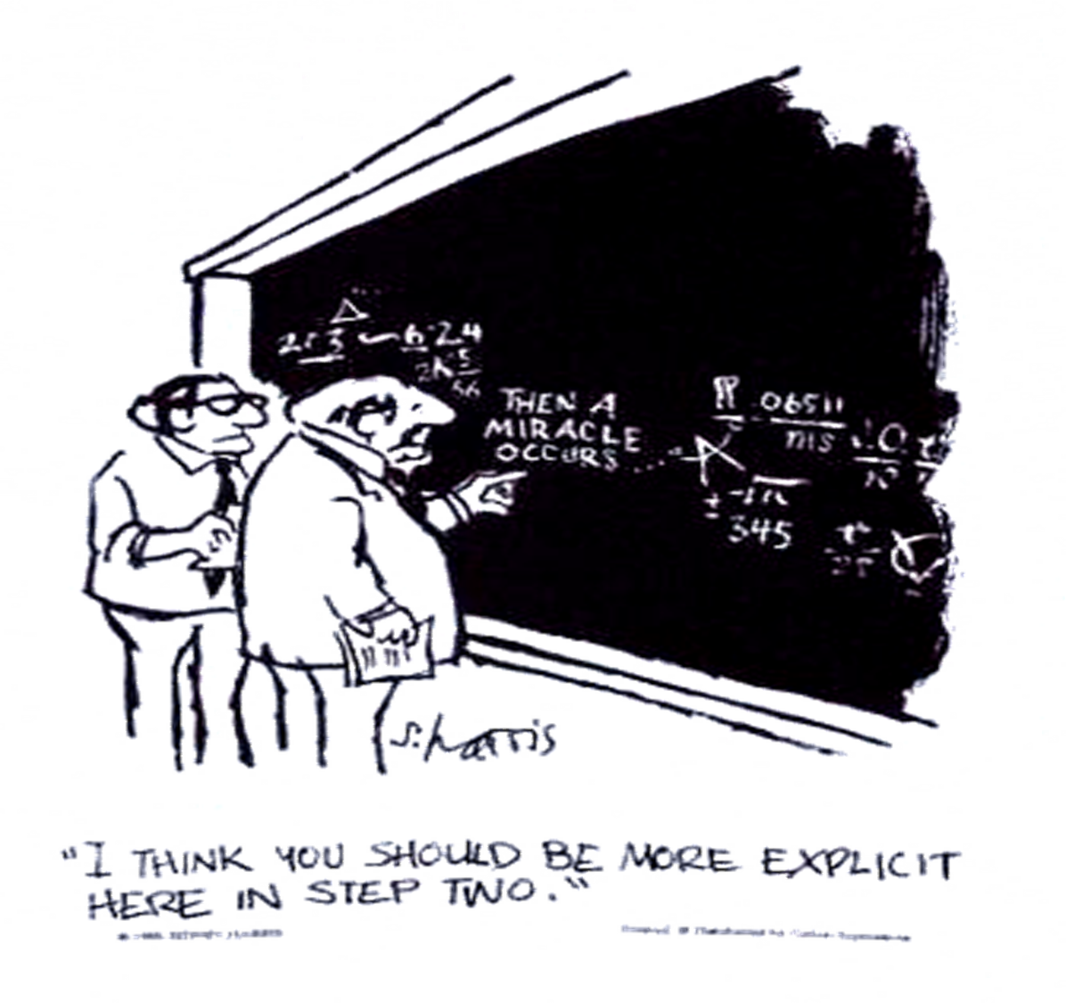
With a little of this…?

Slide 7
Outcomes
“We know that the educational achievement for children with SEN is too low and the gap with their peers too wide. This is a hangover of a system, and a society, which did not place enough value on achieving good outcomes for disabled children and children with SEN” Lamb Inquiry.

Slide 8
Sensory Disability
Specific challenge for the Reforms:
Low incidence makes planning and provision across settings more complex
Need to ensure specialist expertise available at different levels in different settings
Need continuum of provision
Need to ensure very specialist services available regionally
Need to involve specialist teachers for HI/VI/MSI in assessment-CoP requirement
How to ensure young people’s involvement is more complex?

Slide 9
What's Changed?
School Action School Action Plus gone-Single SEN Category
Statements Replaced by and Education Health and Care Plan-personalised and outcome focused
Young people have additional rights post 16
LDA’s replaced by an Education Health and Care Plan
Introduction of a Local Offer

Slide 10
Different Levels of Change
At the level of the Local Offer-the overall strategic development of services and information about them
At the level of Schools through the Schools Information Report and SEN Policy
At the level of individual service provision through the EHC Plan and through the graduated response

Slide 11
Outcomes
Section 19
“support the child and his or her parent, or the young person, in order to facilitate the development of the child or young person and to help him or her achieve the best possible educational and other outcomes”
More specific than “best endeavours” which is also retained
Outcomes focus also at the centre of the Education Health and Care Plan and the new graduated response

Slide 12
Local Offer
4.2 of the Code of Practice:
‘The Local Offer has two key purposes:
To provide clear, comprehensive, accessible and up-to-date information about the available provision and how to access it, and
To make provision more responsive to local needs and aspirations by directly involving disabled children and those with SEN and their parents, and disabled young people and those with SEN, and service providers in its development and review.’

Slide 13
What has been happening?
Parents and young people have been involved in the production of the Local Offer though;
Sitting on strategic committee’s at LA level helping with the content, design and presentation of the Offer
Consulting parents and young people through public meetings, working groups and online consultations
User groups looking at ease of access to testing how well it works
Developing local consultation forums
Linking with local impairment specific forms and groups

Slide 14
Local Offer Challenges
Review on at least a yearly basis-how is this going to take place what mechanisms have been put in place?
Ensuring that parents and young peoples voices continue to be included
Ensuring that comments on the adequacy of the Offer are acted upon and services developed

Slide 15
Education, Health and Care Plans
Personalisation-Plans fit around the young person and family's aspirations and needs
Duty to jointly commission across Education, Health and Social Care-major driver of culture change?
Extension of Education, Health and Care Plans to age 25-new individual rights post 16 though obligations still not clear post 19?

Slide 16
EHC Plans
“It is vital that a timely process is supported by high quality engagement with the child and his or her parents or the young person throughout the assessment, planning and review process.”
CoP 9.7
“Local authorities must consult the child and the child’s parent or the young person throughout the process of assessment and production of an EHC plan…..Planning should start with the individual and local authorities must have regard to the views, wishes and feelings of the child, child’s parent or young person, their aspirations, the outcomes they wish to seek and the support they need to achieve them. It should enable children, young people and parents to have more control over decisions about their support including the use of a Personal Budget for those with an EHC plan.”
CoP 9.21

Slide 17
What has been happening-EHC Plans?
Many authorities adopting person centred planning approach for ECH Plans-early feedback is that these are more popular with parents but still issues about involvement of Health and Social Care
Transition meetings often being done with schools staff-issues of competence and training but schools staff are also often trusted by parents
Parents and young people are feeling more involved in the process where it is being done in a more person centred way

Slide 18
Challenges
Time taken to do new process still a major challenge if LA’s are to deliver new levels of parental and young persons engagement
Ensuring that provision is developed locally which provides a good “offer” for young people
How to write plans which are really Outcome focused not just provision led
Examples of how not to do it from recent plans;
Outcome is to get a plan
Outcome is to get a speech therapist
Outcome is to be a ski instructor

Slide 19
How well is it working?
72% of respondents were moderately to extremely confident that the education, health and care assessment pathway that their Local Authority has developed with parents, young people and partners, is compliant with the law.
69% of respondents were moderately to extremely confident that the education, health and care assessment pathway that their Local Authority has developed with parents, young people and partners will meet the 20 week statutory deadline.
84% of respondents confirmed that their Local Authorities’ local offer include information about sources of information, advice and support in the LA’s area relating to SEN and disabilities, including Independent Supporters.
Only 28% of respondents stated their local offer covered information about the Local Authorities’ accessibility strategy.
45% of respondents confirmed that most to all of the schools in their Local Authority has a clear system for identifying and responding to SEN, including SEN support, however 27% did not know.
64% of respondents confirmed that their Local Authorities’ impartial information, advice and support is well developed or fully in line with the new requirements.
90% confirmed their IAS service has an offer for parents/carers, 75% confirmed it has an offer to young people and 72% confirmed it had an offer to children.
Parent Carer Forums Survey 4: - Implementation of the SEND Reforms April 2015

Slide 20
Local Authorities View
93% of LAs who responded felt that practitioners are ensuring that families are experiencing person-centred reviews as part of the EHC needs and assessment pathways extremely well or quite well.
93% of LAs who responded were extremely or very confident that their EHC assessment pathways they have developed are compliant with the Code of Practice.
59% of LAs who responded were extremely or very confident that EHC plans will meet the 20 week deadline. (only 64% actually did!)
The percentage of LAs who were extremely or very confident that Year 1 Priority Transfers will be completed within the timescale has decreased from 52% in October to 40% in February.
32% of LAs stated in February they are receiving more requests for new assessments compared to the same period last year, an increase on 23% in October.
25% of respondents stated they have had the same number of new requests for assessment in the first 6 weeks of the new system compared to a year ago;
44% of respondents had had fewer requests.

Slide 21
Schools Duties
Parents must be told when their child is identified as having SEN and a plan must be produced and shared with the parent (CoP 5.15 and 6.39)
The focus in the plan must be on children and young peoples outcomes (CoP 6.40-41)
Children and Young People are routinely involved in those discussion where appropriate (CoP 1.1-2)
Schools should meet with parents at least three times a year to discuss progress and interventions (CoP 6.64-66) and schools must provide an annual report to parents on the child’s progress (CoP 6.64) Schools may want to go beyond this and produce regular reports (schools will not be producing IEP’s)
SEN Information Report paints a clear picture of what the Schools Offer is for parents, children and young people (CoP 6.79) Parents are involved in the production of the report.
There is a clear process for discussing if an Education Health and Care Plan is needed and young people and parents fully involved in decisions about the future (CoP 6.63)

Slide 23
Schools-What has been happening?
Schools have been extending the principles behind person centred planning to all SEN pupils in Schools e.g. Essex One Plan
Schools Information Reports have now been produced by most schools but of varying quality and how many co-produced?
Linkages beginning to made with what is available in schools and the local offer-what is routinely available at school level for the delegated budget?
LA’s coproducing charters or principles for engagement with parents at any level of the system.
Tribunal will start taking into account what Schools put in the Schools Information Report in Tribunal cases especially relevant on placement decisions.
OFTED/CQC could take into account as part of new inspection framework

Slide 24
Challenges for next stages
We need to ensure that parental engagement is embedded as “the way we do things around here”
Quality and consistency of engagement in producing and reviewing EHC Plans and support before a plan with a focus on better outcomes
Ensuring that Health and Social Care are fully engaged
Ensure that the Local Offer provides the support to young people’s future

Slide 25
What will success look like?
Outcomes gap closing and children with SEN reaching their full capabilities
Parent Trust in system increased
Change in the culture through working together
Professional confident about their role and schools welcoming children with SEND
Young people have their views listened to

Slide 27
Contact Details
Brian.publicaffairs@gmail.com

